Slide 1

Cyclistic Case Study
Presented by :Mahmoud Hassan
Last updated : November 30th, 2022

Slide 2
Cyclistic Case Study
1-purpose statement(what are we talking about?)
2-tell your story (with data )
3-conclusion
4-appendix

Slide 3
What Are We Talking About?

Slide 4
Purpose
Support decision-making process behind supporting or opposing marketing strategies
aimed at converting casual riders into annual members
Objective
- How Do Annual Members And Casual Riders Use Cyclistic bikes Differently?
- What Does Each Group Need ?

Slide 5
Presented Data

Slide 6
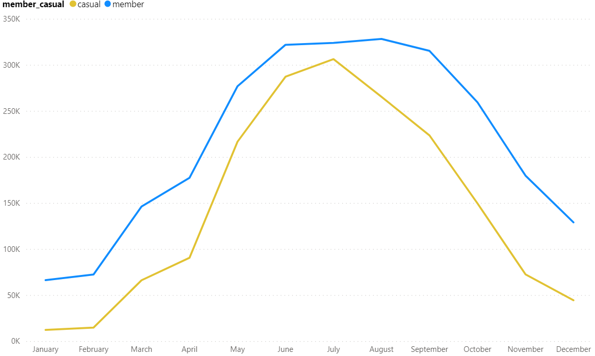
Count Trips Per Month
-count trips in the last 12 month
-there is increasing in trips in summer for annual members and casual riders
-this chart is not a strong indicator about difference between annual members and casual riders

Slide 7
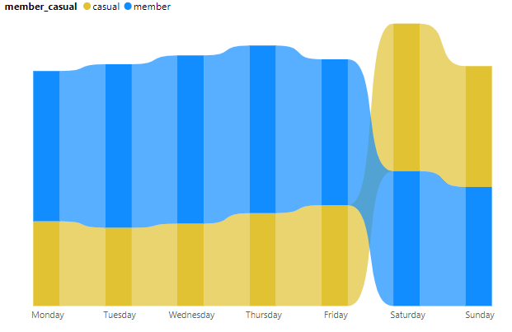
Count Trips Per Day
-there is an increasing in trips at the weekend and decreasing on working days for casual riders
-there is an increasing in trips on working days and decreasing at the weekends for annual members

Slide 8
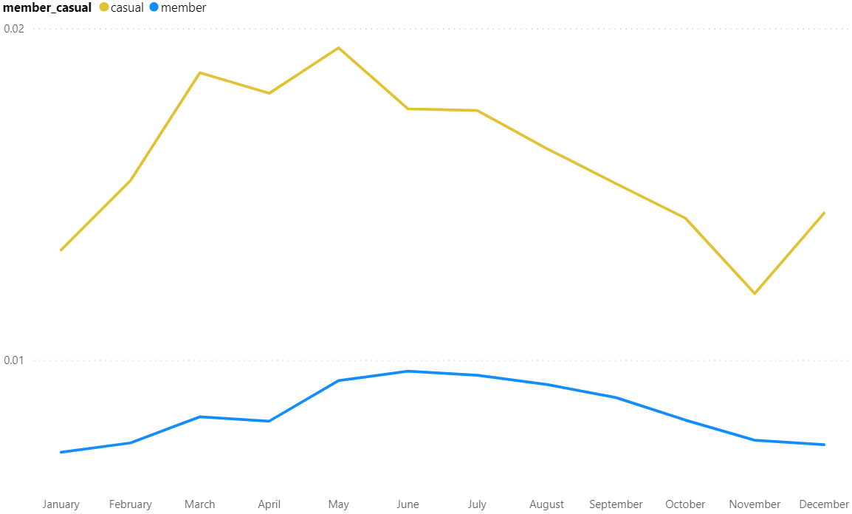
Average Ride Length
-there is an increasing in average ride length for casual riders more than annual members

Slide 9
Conclusion

Slide 10
1
2
3
Casual riders have many trips on weekends.
annual members riders have many trips on working days.
average ride length for casual riders more than annual members
The evidence is inconclusive.
There may be more than meets the eye.
Moving forward as is with a conversion marketing strategy is risky

Slide 11
Recommendations

Slide 12
1
2
3
Preference for annual members bike reservations during peak cycling season
Yearly subscription providing an un limited pass for every weekend
Focus on the benefits of cycling on health and the environment

Slide 13
Appendix

Slide 14
Attributions
- I used Cyclistic’s historical trip data to analyze and identify trends , I Downloaded the previous 12 months of Cyclistic trip data here.
-The data has been made available by Motivate International Inc. under this license.
-Data from December 2021 through November 2022

Slide 15
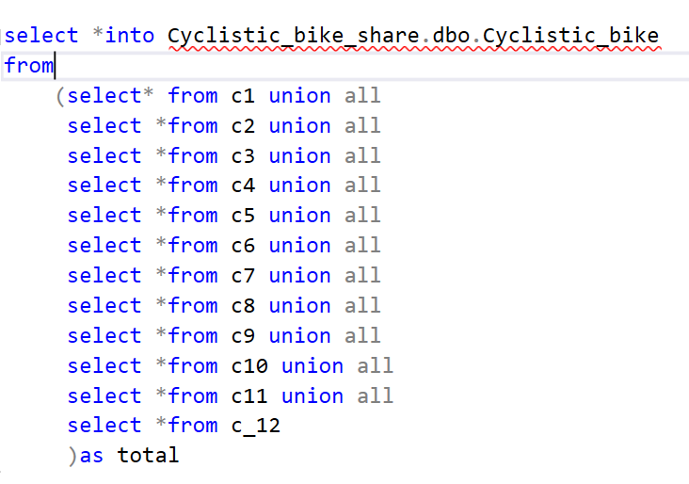
Cleaning and processing data
Data was cleaned using SQL
1- importing data from csv to MS SQL server

Slide 16
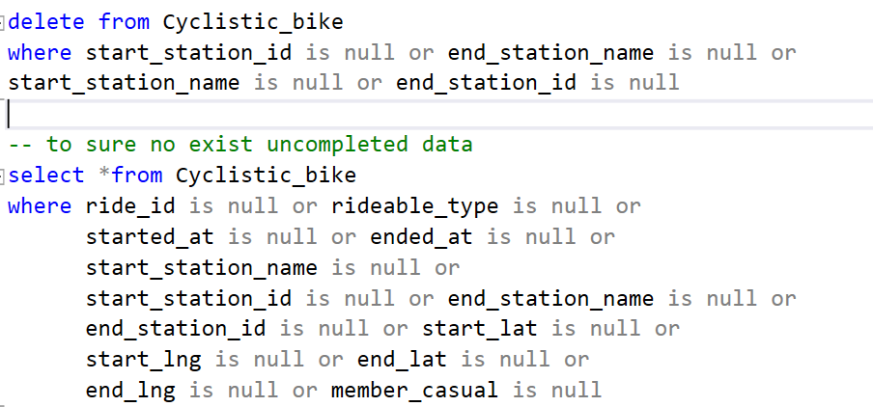
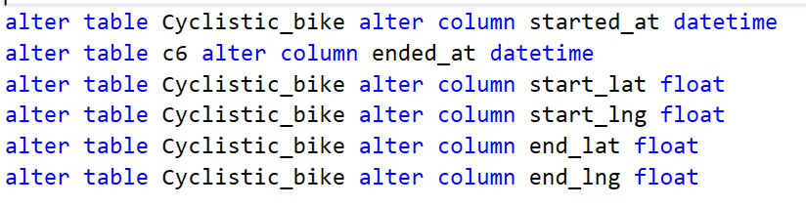
2- delete uncompleted data
3- convert data of column type from one to another suitable

Slide 17
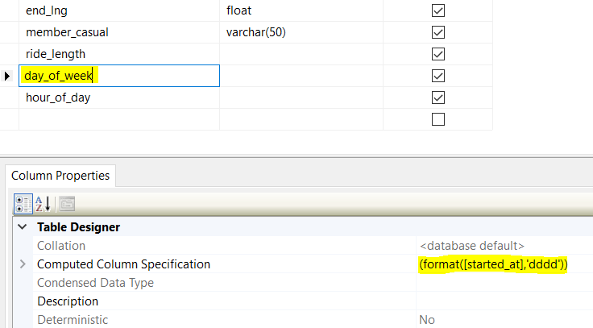
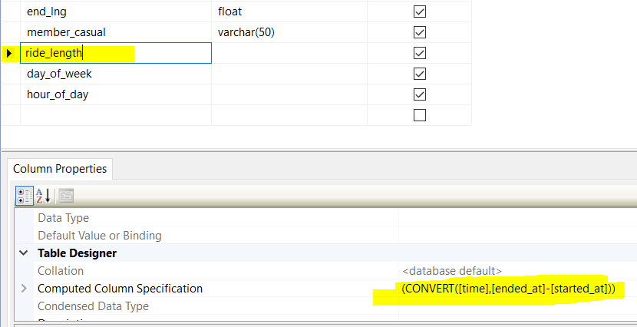
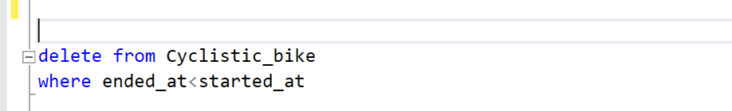
4- Add driven column to calculate ride_length , drive_hours and day_of_week
Go to column properties and add a formula in computed column specification
5- delete error data

